Slide 1
Q3 2023 Earnings and Business Update Call

Slide 2
Disclaimers
This presentation contains forward-looking statements that discuss expectations as to future trends, plans, events, results of operations or financial condition, or state other information relating to Sanara MedTech Inc. (the “Company,” “Sanara,” “we,” “our” or “us”). All statements other than statements of historical fact contained herein are forward-looking statements. These statements may be identified by terms such as “aims,” “anticipates,” “believes,” “contemplates,” “continue,” “could,” “estimates,” “expect,” “forecast,” “guidance,” “intend,” “may,” “plan,” “possible,” “potential,” “predicts,” “preliminary,” “projects,” “seeks,” “should,” “targets,” “will,” or “would,” or the negatives of these terms, variations of these terms or other similar expressions. These forward-looking statements include, among others, statements concerning the potential benefits created by the acquisition of certain assets related to the Company’s collagen products business, the anticipated impact of such acquisition on the Company’s business and future financial operating results, the Company’s ability to develop and commercialize the new collagen-based products currently under development, including the manufacturing, distribution, marketing, and sales of such products, the Company’s ability to maintain or replace the manufacturing and distribution process of the sellers in the acquisition, including with vendors, capital raising plans, the development and launch of new products, the timing of commercialization of our products, the regulatory process and expansion of the Company’s business in telehealth and wound care. These items involve risks, contingencies and uncertainties such as uncertainties associated with the development and process for obtaining regulatory approval for new products, the extent of product demand, market and customer acceptance, the effect of economic conditions, competition, pricing, the ability to consummate and integrate acquisitions, and other risks, contingencies and uncertainties detailed in the Company’s filings with the Securities and Exchange Commission (“SEC”), including the Company’s most recently filed Annual Report on Form 10-K and the Company’s Quarterly Reports on Form 10-Q as well as other documents the Company files with the SEC. Investors and security holders are urged to read these documents free of charge on the SEC’s website at http://www.sec.gov. Forward-looking statements contained in this presentation are made as of this date, and the Company undertakes no obligation to publicly update any forward-looking statement, whether as a result of new information, future events, or otherwise, except as required by applicable securities laws.
This presentation contains statistical and market data that we obtained from industry publications, reports generated by third parties, third-party studies and public filings. Although we believe that the publications, reports, studies and filings are reliable as of the date of this presentation, we have not independently verified such statistical or market data.
The trademarks and service marks included herein are the property of the owners thereof and are used for reference purposes only. Such use should not be construed as an endorsement of such products.
This presentation shall not constitute an offer to sell or the solicitation of an offer to buy securities, nor shall there be any sales of securities, in any state or jurisdiction in which such an offer, solicitation, or sale would be unlawful prior to registration or qualification under the securities laws of any such state or jurisdiction.
CAUTION: This presentation concerns certain products that are under clinical investigation and which have not yet been cleared for marketing by the U.S. Food and Drug Administration. These products are currently limited by federal law to investigational use, and no representation is made as to the safety or effectiveness of these products for the purposes for which they are being investigated.

Slide 3
Overview
Commentary on Q3 2023
Financial Update (Unaudited)
Highest net revenue quarter in the Company’s history ($16.0 million).
Loss before income taxes narrowed from $3.2 million to $1.1 million in Q3 YOY.
Net loss of $1.1 million in Q3 2023 compared to $1.5 million in Q3 2022.
Adjusted EBITDA¹ of $0.3 million in Q3 2023 compared to Adjusted EBITDA of negative $1.6 million in Q3 2022.
Collagen Products Asset Acquisition
Included all rights and ownership (for human wound care uses) for certain 510(k) cleared collagen-based wound care products including CellerateRX® Surgical Activated Collagen (“CellerateRX® Surgical”) and HYCOL ® Hydrolyzed Collagen (“HYCOL”).
Initial purchase price of $15.25 million (consisting of $9.75 million in cash paid at closing, shares of the Company’s common stock with an agreed upon value of $3.0 million, and four equal annual installments of $625,000 in cash) and up to $10.0 million in future earnout payments, as well as certain royalties and incentive payments on future products that are developed.
Innovation
ALLOCYTE® Plus Advanced Viable Bone Matrix (“ALLOCYTE® Plus”) first sale subsequent to the end of the quarter in early October 2023.
BIASURGE™ Advanced Surgical Solution (“BIASURGE™”) first sale subsequent to the end of the quarter in early November 2023.
ATM Offering
The ATM offering was paused at the end of Q1. We do not currently plan to reactivate the ATM.
Adjusted EBITDA is a non-GAAP financial measure. See the discussion and reconciliation in the appendix for additional information.

Slide 4
Building a Leading Medical Technology Company Multi-year Growth Strategy
Constructing a leading medical technology platform…
2021
Rochal asset acquisition (brought R&D in-house)
Launched Cook Biotech Inc. products (expanded product offering)
2022
Scendia Biologics acquisition (expanded product offering)
2023
Acquisition of assets related to collagen products (acquired all rights for key products)
Signed major national GPO (contributed to a 67% increase in hospital approvals¹)
BIASURGETM commercial launch in early November 2023 (expanded product offering with greenfield opportunity)
…that is positioned to accelerate the next phase of Sanara’s growth
Metrics Driven Expansion In Facilities, Deployment, And Additional Specialties
Expand Product Portfolio
Target Strategic M&A
In-House R&D and Commercialization
Percent increase in hospital approvals is from March 31, 2023 to June 30, 2023.

Slide 5
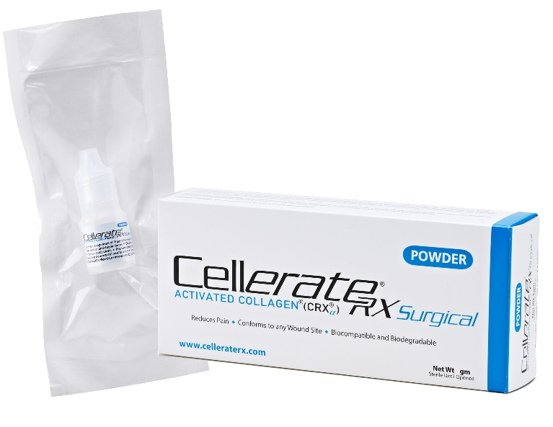
Surgical Sales
Q3 2023 Sales Overview (Unaudited)
Q3 rate of sales growth was impacted due to:
Continued ALLOCYTE® supply issues
CellerateRX ® usage levels negatively impacted growth in four territories. These territory challenges have been analyzed and appropriate adjustments have been made.
Company believes the ALLOCYTE® supply issue has been resolved through the availability of ALLOCYTE® Plus and is reengaging with customers.
Our products were sold in over 1,000 hospitals/ASCs across 32 states plus the District of Columbia⁽¹⁾ in the TTM. A 33rd state missed our TTM revenue cutoff by less than $2,000.
Our products were contracted or approved to be sold in more than 3,000 hospitals/ASCs as of September 30, 2023.
Leveraging field intelligence and data analytics, we have hired twelve new sales representatives (net +7) this year prior to the end of Q3; expected material impact on sales within 6-9 months after initial hire date.
Based on a minimum of $50,000 revenue in the TTM.

Slide 6
Surgical Sales (continued)
Q3 2023 Sales Overview
Sales of soft tissue products were $13.6 million in Q3 (CellerateRX®, FORTIFY TRG® Tissue Repair Graft, FORTIFY FLOWABLE® ECM, and TEXAGEN® Amniotic Membrane Allograft)
Sales of bone fusion products were $2.3 million in Q3 (BiFORM® Bioactive Moldable Matrix, AMPLIFY™ Verified Inductive Bone Matrix, and ALLOCYTE® Advanced Cellular Bone Matrix)

Slide 7
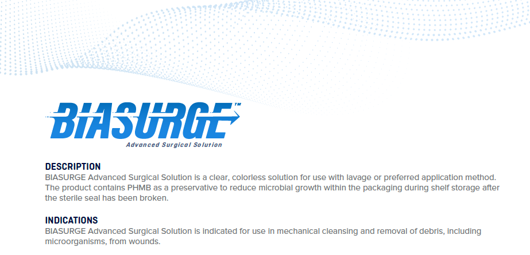
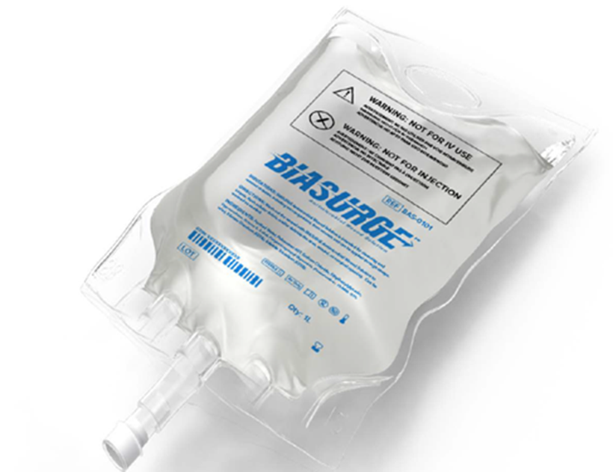
BIASURGE™ – Product Launch
Launch Details
Exhibited and launched BIASURGE™ at AAHKS (American Association of Hip and Knee Surgeons) conference in November 2023.
First sale in early November 2023.
Was trialed prior to launch with physicians and initial feedback has been positive.
Company believes that this product could be used in any surgery where Sanara products are currently used.
Currently adding BIASURGE™ to new and existing facility contracts.
Added to 41 facility contracts prior to launch.

Slide 8
Collagen Products Asset Acquisition
Overview
Strategic Rationale
Consideration
Assets acquired from the sellers include:
Certain 510(k) cleared collagen-based wound care products including CellerateRX® and HYCOL® for human wound care cases.
Nine patents and all of the sellers’ patents pending for collagen products for human wound care uses and five trademarks.
Gives Sanara control of the manufacturing process for CellerateRX® and HYCOL® which is expected to reduce costs.
Gives Sanara full rights to develop new collagen products for human wound care uses based on the acquired technology.
CellerateRX®
HYCOL®
New application formats
Eliminates the royalty paid on CellerateRX® and HYCOL® to sellers.
Total initial consideration of $15.25 million consisting of $9.75 million in cash paid at closing, shares of the Company’s common stock with an agreed upon value of $3.0 million, and four equal annual installments of $625,000 in cash.
Potential earnout payments of up to $10.0 million, as well as certain royalties and incentive payments on future products that are developed.
Cash at closing was funded through a loan provided by Cadence Bank.

Slide 9
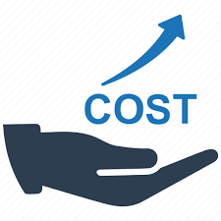
Tissue Health Plus (Formerly WounDerm)
Post-Acute Value-Based Care Strategy
Exploring ways to accelerate commercialization or find an appropriate partner that can add a value-based component to this strategy.
Total 2023 costs through the end of Q3 2023 were $5M+.
Key Market Drivers
1st value-based wound prevention and treatment program targeting Payers and risk bearing entities. Bundles advanced products, wound care technology, and clinical delivery
Aging Population
Products
Technology
Delivery
Acute Shortage of Wound Care Expertise
Advanced dressings
Advanced wound biologics
Negative pressure pumps
Point of care imaging
Point of care diagnostics
Clinician pathway guidance
Remote patient monitoring
Patient education & engagement
Virtual care coordination & navigation center
Integrated MSO network of travelling wound provider groups, podiatrists & home health clinicians
Integration with primary care physicians
Spiraling Wound Care Costs
Demand for Value-Based Models
~$5.25B opportunity = 15% of ~$35B ⁽¹⁾ ⁽²⁾ total annual spend (Medicare + Medicare Advantage + Employer)
For Medicare & Medicare Advantage Spend :https://doi.org/10.1080/13696998.2023.2232256.
For Employer Spend: THP estimate based on chronic wound prevalence, average wound treatment cost, and number of employed U.S adults

Slide 10
Q3 2023 Financial Highlights
Overview (Unaudited)
Revenue
For the three months ended September 30, 2023, we generated net revenue of $16.0 million compared to net revenue of $13.0 million for the three months ended September 30, 2022, a 23% increase from the prior year period.
For the nine months ended September 30, 2023, we generated net revenue of $47.3 million compared to net revenue of $30.5 million for the nine months ended September 30, 2022, a 55% increase from the prior year period.
The higher net revenue for the three and nine months ended September 30, 2023 was primarily due to increased sales of soft tissue repair products and to a lesser extent, bone fusion products, as a result of our increased market penetration and geographic expansion, additional revenues as a result of the Scendia acquisition and our continuing strategy to expand our independent distribution network in both new and existing U.S. markets.
SG&A
SG&A expenses for the three months ended September 30, 2023, were $13.9 million compared to SG&A expenses of $12.1 million for the three months ended September 30, 2022.
SG&A expenses for the nine months ended September 30, 2023, were $40.7 million compared to SG&A expenses of $31.9 million for the nine months ended September 30, 2022.
The higher SG&A expenses for the three and nine months ended September 30, 2023 were primarily due to higher direct sales and marketing expenses, which accounted for approximately $1.0 million and $6.8 million, respectively, or 56% and 77%, respectively, of the increases compared to the prior year periods.
The higher direct sales and marketing expenses for the three and nine months ended September 30, 2023 were primarily attributable to an increase in sales commissions of $0.7 million and $5.9 million, respectively, as a result of higher product sales. The nine months ended September 30, 2023 also included $0.8 million of increased costs as a result of sales force expansion and operational support.

Slide 11
Q3 2023 Financial Highlights (Continued)
Overview (Continued)
R&D Expenses
R&D expenses for the three months ended September 30, 2023, were $1.0 million compared to $1.1 million for the three months ended September 30, 2022.
R&D expenses for the nine months ended September 30, 2023, were $3.5 million compared to $2.3 million for the nine months ended September 30, 2022.
The higher R&D expenses for the nine months ended September 30, 2023 were primarily due to costs related to the Precision Healing diagnostic imager and LFA. These expenses also included costs associated with ongoing development projects for our currently licensed products.
Loss Before Income Taxes
We had a loss before income taxes of $1.1 million for the three months ended September 30, 2023, compared to a loss before income taxes of $3.2 million for the three months ended September 30, 2022.
For the nine months ended September 30, 2023, we had a loss before income taxes of $4.2 million, compared to a loss before income taxes of $9.8 million for the nine months ended September 30, 2022.
The lower loss before income taxes for the three and nine months ended September 30, 2023 was due to operating expenses increasing at a slower rate than net sales in addition to the benefit recorded as a result of the change in fair value of earnout liabilities.
Net Loss
For the three months ended September 30, 2023, we had a net loss of $1.1 million, compared to a net loss of $1.5 million for the three months ended September 30, 2022.
For the nine months ended September 30, 2023, we had a net loss of $4.2 million, compared to a net loss of $3.9 million for the nine months ended September 30, 2022.
Cash Balances at End of Quarter (in millions)
$10.3 (Q3-22), $9.0 (Q4-22), $7.3 (Q1-23), $6.1 (Q2-23), $6.2 (Q3-23)

Slide 12
Questions

Slide 13
Appendix

Slide 14
Non-GAAP Financial Measure
Use of Non-GAAP Financial Measure
To supplement the Company’s financial information presented in accordance with generally accepted accounting principles in the United States (“GAAP”), we present certain non-GAAP financial measures in this press release and on the related teleconference call, including Adjusted EBITDA. The Company’s management uses these non-GAAP financial measures, both internally and externally, to assess and communicate the financial performance of the Company. The Company defines Adjusted EBITDA as net loss excluding interest for term loan, debt issuance cost amortization, accretion of finance liabilities, provision/benefit for income taxes, depreciation and amortization, non-cash share-based compensation expense, change in fair value of earnout liabilities, and gains/losses from the disposal of property and equipment. The Company’s believes Adjusted EBITDA is useful to investors because it facilitates comparisons of its core business operations across periods on a consistent basis. Accordingly, the Company adjusts for items such as change in fair value of earnout liabilities when calculating Adjusted EBITDA because the Company believes that it is not related to the Company’s core business operations.
The Company’s non-GAAP financial measures are not in accordance with, nor an alternative for, measures conforming to GAAP and may be different from non-GAAP financial measures used by other companies. In addition, these non-GAAP financial measures are not based on any comprehensive set of accounting rules or principles. The Company continues to provide all information required by GAAP, but it believes that evaluating its ongoing operating results may not be as useful if an investor or other user is limited to reviewing only GAAP financial measures. The Company does not, nor does it suggest that investors should, consider these non-GAAP financial measures in isolation from, or as a substitute for, financial information prepared in accordance with GAAP. Material limitations associated with the use of such measures include that they do not reflect all costs included in operating expenses and may not be comparable with similarly named financial measures of other companies. Furthermore, these non-GAAP financial measures are based on subjective determinations of management regarding the nature and classification of events and circumstances. The Company presents these non-GAAP financial measures to provide investors with information to evaluate the Company’s operating results in a manner similar to how management evaluates business performance. To compensate for any limitations in such non-GAAP financial measures, management believes that it is useful in understanding and analyzing the results of the business to review both GAAP information and the related non-GAAP financial measures. Whenever the Company uses a non-GAAP financial measure, it provides a reconciliation of the non-GAAP financial measure to the most directly comparable GAAP financial measure. Investors are encouraged to review and consider these reconciliations.

Slide 15
Reconciliation of GAAP to Non-GAAP Financial Measures

